Slide 1
Asynchronous Data Transfer
When two units such as CPU and I/O interface, If the registers in the interface share a common clock with the CPU registers, the transfer between the two units is said to be synchronous.
Asynchronous Data Transfer: Asynchronous data transfer between two independent units requires that control signals be transmitted between the communicating units independently to indicate the time at which data is being transmitted.
There are two methods to achieve this
1. Strobe Control
The Strobe control method of asynchronous data transfer employs a single control line to time each transfer.
Source-initiated strobe for data transfer
The strobe may be activated by either the source or the destination unit.
The data bus carries the binary information from source unit to the destination unit.
The source unit first places the data on the data bus.

Slide 2
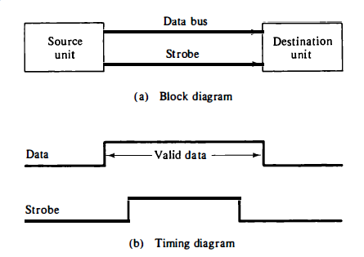

Slide 3
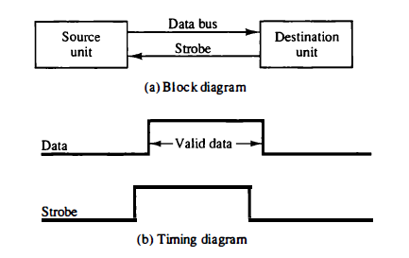
After a delay to ensure that the data settle, the source activates the strobe pulse.
The information on the data bus and the strobe signal remain in the active state for a sufficient time period to allow the destination unit to receive the data.
The source removes the data from the bus a brief period after it disables its strobe pulse which indicates that the data bus does not contain valid data.
Destination-initiated strobe for data transfer

Slide 4
A data transfer initiated by the destination unit. In this case the destination unit activates the strobe pulse, informing the source to provide the data.
The source unit responds by placing the requested binary information on the data bus.
The data must be valid and remain in the bus long enough for the destination unit to accept it.
The destination unit then disables the strobe. The source removes the data from the bus after a predetermined time interval.
Disadvantage of Strobe method:
The disadvantage of the strobe method is that the source unit that initiates the transfer has no way of knowing whether the destination unit has actually received the data item that was placed in the bus
Similarly, a destination unit that initiates the transfer has no way of knowing whether the source unit has actually placed the data on the bus.

Slide 5
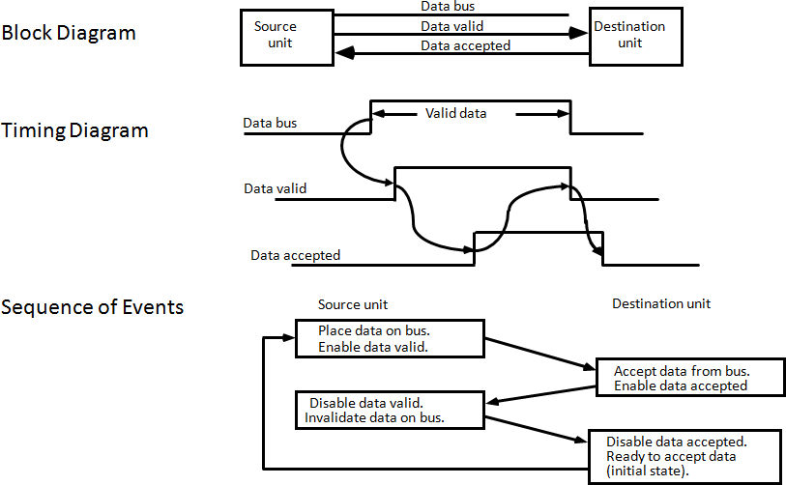
2. Handshaking method
The handshake method solves the problem of Strobe method by introducing a second control signal that provides a reply to the unit that initiates the transfer.
Source-initiated transfer using handshaking

Slide 6
One control line is in the same direction as the data flow in the bus from the source to the destination. It is used by the source unit to inform the destination unit whether there are valid data in the bus.
The other control line is in the other direction from the destination to the source. It is used by the destination unit to inform the source whether it can accept data.
The sequence of control during the transfer depends on the unit that initiates the transfer.
The two handshaking lines the data valid, which is generated by the source unit, and data accepted, generated by the destination unit, the timing diagram shows the exchange of signals between the two units.
The sequence of events listed in figure shows the four possible states that the system can be at any given time.
The source unit initiates the transfer by placing the data on the bus and enabling its data valid signal.

Slide 7
The data accepted signal is activated by the destination unit after it accepts the data from the bus.
The source unit then disables its data valid signal, which invalidates the data on the bus.
The destination unit then disables its data accepted signal and the system goes into its initial state.
The source does not send the next data item until after the destination unit shows its readiness to accept new data by disabling its data accepted signal.

Slide 8
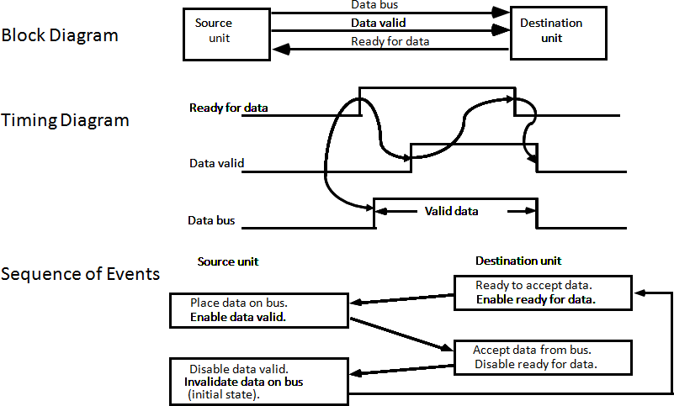
Destination-initiated transfer using handshaking

Slide 9
The destination-initiated transfer using handshaking lines is shown in figure
The source unit in this case does not place data on the bus until after it receives the ready for data signal from the destination unit.
From there on, the handshaking procedure follows the same pattern as in the source- initiated case.

